Slide 1
Layered architecture for IoT
P KALAIVANI
Assistant Professor / CSE
Kongu Engineering College

Slide 2
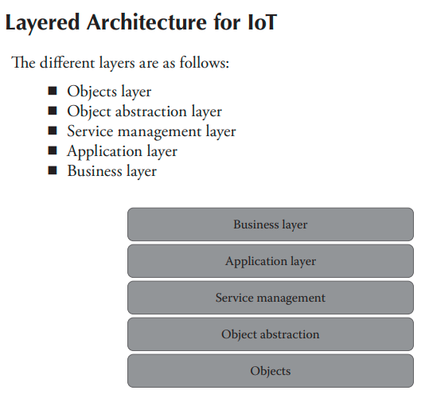

Slide 3
Objects Layer
Objects layer, also known as devices layer, comprises the physical devices that are used to collect and process information from the IoT ecosystem.
Physical devices include different types of sensors such as those that are typically based on micro-electromechanical systems (MEMS) technology
Standardized plug and play mechanisms should be used by the objects layer in order to integrate and configure the heterogeneous types of sensors that belong to the IoT device ecosystem.
The device data that are collected at this layer are transferred to the object abstraction layer using secure channels

Slide 4
Object Abstraction Layer
Transfers data that are collected from objects to service management layer using secure transmission channels.
Data transmission can happen using any of the following technologies:
◾ RFID ◾ 3G ◾ GSM ◾ UMTS ◾ Wi-Fi
◾ Bluetooth low energy ◾ Infrared ◾ ZigBee
Specialized processes for handling functions such as cloud computing and data management are also present in this layer.

Slide 5
Service Management Layer
Acts as middleware for the IoT ecosystem.
Pairs specific services to its requester based on addresses and names.
Provides flexibility to the IoT programmers to work on different types of heterogeneous objects irrespective of their platforms.
This layer also processes the data that are received from the object abstraction layer.
After data processing, necessary decisions are taken about the delivery of required services, which are then done over network wire protocols.

Slide 6
Application Layer
Provides the diverse kinds of services requested by the customer.
The type of service requested by the customer depends on the specific use case that is adopted by the customer.
For example, if smart home is the use case under consideration, then the customer may request for specific parameters such as heating, ventilation, and air conditioning (HVAC) measurements or temperature and humidity values.
This layer provides the various types of smart services, which are offered by various IoT verticals.
◾ Smart cities ◾ Smart energy ◾ Smart health care
◾Smart buildings or homes ◾ Smart living
◾ Smart transportation ◾ Smart industry

Slide 7
Business Layer
Performs the overall management of all IoT activities and services.
Uses the data that are received from the network layer to build various components such as business models, graphs, and flowcharts.
Has the responsibility to design, analyze, implement, evaluate, and monitor the requirements of the IoT system.
Has the capability to use big data analysis to support decision-making activities.
This layer also performs a comparison of obtained versus expected outputs to enhance the quality of services

Slide 8
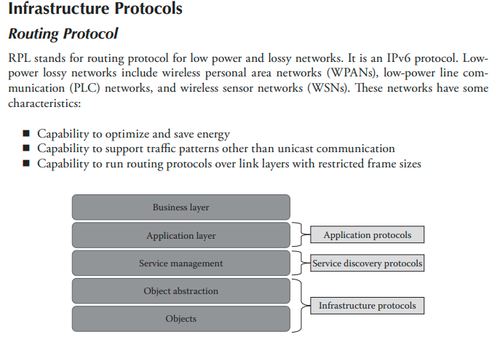
Protocol Architecture of IoT

Slide 9
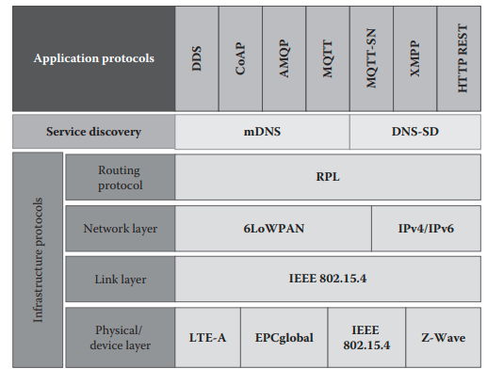
Categorization of IoT protocols.

Slide 10
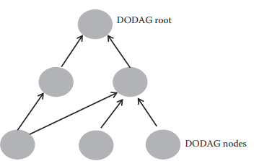
DODAG topology
RPL was designed to support minimal routing needs by building a highly robust topology over lossy networks. Support for various types of traffic models: multi-point-to-point, point-to-multipoint, and point-to-point.
Devices in the network that use this protocol are connected to each other in such a way that no cycles are present in the connection.
In order to achieve this, a node called destination oriented directed acyclic graph (DODAG), which is routed at a single destination, is built initially.
RPL specifications refer to DODAG as DODAG root. Each node that is a part of DODAG knows its parent node but does not have any information about its child nodes.
RPL maintains at least a single path from each node to the root and the preferred parent. This is done in order to increase performance by pursuing a faster path. The DODAG topology used in RPL is depicted in the following

Slide 11
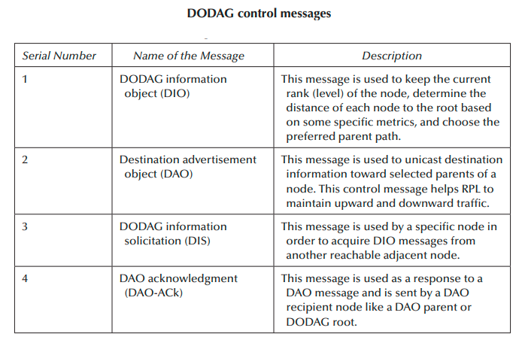

Slide 12
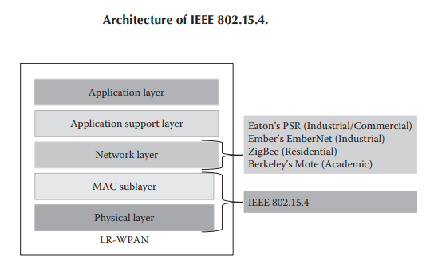
This protocol was created in order to specify a sub layer for the medium access control (MAC) and physical layer primarily for low-rate wireless private area networks.
This protocol also provides reliable communication and can handle a huge number of nodes (approximately about 65K nodes). T

Slide 13
IEEE 802:15.4 (Cont..)
The only negative side of this protocol is that it does not provide any quality of service (QoS) guarantees.
This protocol forms the basis of ZigBee and other protocols that are used in IoT communication.
Supports transmission at three frequency bands using a direct sequence spread spectrum (DSSS) method. On the basis of frequency channel, data transmission happens at three data rates:
◾ 250 kbps at 2.4 GHz ◾ 40 kbps at 915 MHz ◾ 20 kbps at 868 MHz
This protocol supports two types of network nodes:
◾ Full function devices (FFD)
◾ Reduced function devices (RFD)

Slide 14
Full Function Devices (FFD)
FFDs can act as personal area network (PAN) coordinator or as just a normal node.
The coordinator has the capability to create, control, and maintain the network.
FFDs can store routing table within their memory and can implement a MAC.
They can also communicate with other devices using one of the following topologies: ◾ Star ◾ Peer-to-peer ◾ Cluster-tree

Slide 15
Reduced Function Devices (RFD)
RFDs are very simple nodes, and they have constrained resources. They can only communicate with a coordinator node using only the star topology.
Star topology: This contains at least one FFD and a few other RFDs.
The FFD that is designated to work as a PAN coordinator should be located at the center of the network.
This FFD has the responsibility of managing and controlling all other nodes that are a part of the network

Slide 16
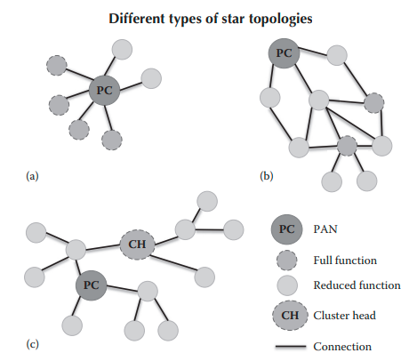
◾ Peer-to-peer topology: This contains a PAN coordinator and other nodes communicate with each other in the same network or through intermediate nodes to other networks.
◾ Cluster-tree topology: This is a special kind of the peer-to-peer topology. It consists of a PAN coordinator, a cluster head, and normal nodes.

Slide 17
6LoWPAN - IPv6 over Low-Power Wireless Personal Area Networks
It is an open standard defined in RFC 6282 by the Internet engineering task force (IETF).
The key feature of 6LoWPAN that makes it suitable for IoT communication is that though it was originally designed to support IEEE 802.15.4 low-power wireless networks in the 2.4-GHz band.
It now supports a wide range of networking media such as sub-1 GHz low-power RF, Bluetooth smart, power line control (PLC), and low-power Wi-Fi.

Slide 18
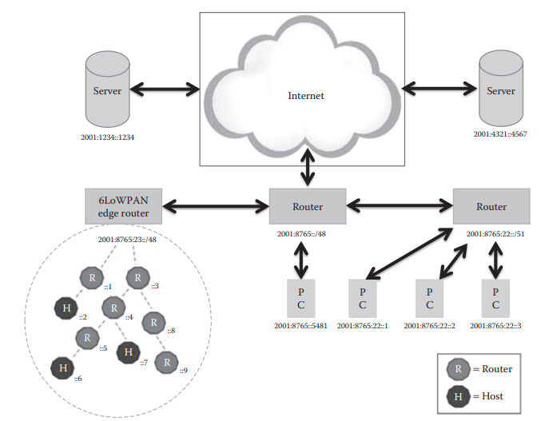
Network architecture of 6LoWPAN

Slide 19
Network architecture of 6LoWPAN
The uplink to the Internet is provided by the access point (AP), which in this case is an IPv6 router.
Different types of devices such as PCs and servers could be connected to the AP.
The components of the 6LoWPAN network are connected to the IPv6 network using a 6LoWPAN edge router.
Functions performed by the edge router:
◾ It enables exchange of data between 6LoWPAN devices and the Internet (or other IPv6 network).
◾ It enables exchange of data among devices that are part of 6LoWPAN network.
◾ It helps to generate and maintain the 6LoWPAN network

Slide 20
6LoWPAN Networks (Cont..)
As 6LoWPAN networks can communicate natively with IP networks, they are connected to IP networks simply using IP routers.
In general, 6LoWPAN networks will typically act as stub networks as they always operate on the edge.
The edge routers that are used to connect 6LoWPAN networks to other IP networks forward IP data grams between different media that are used in IP networks.
The media used in IP network could be Ethernet, Wi-Fi, 3G, or 4G. As the edge routers used in the 6LoWPAN network forward data grams to other IP networks using network layer, they do not maintain the state of application layer.
This in turn lowers the workload on the edge router in terms of processing power, which makes it possible to use low cost embedded devices with simple software as edge routers.
The devices that are present in a 6LoWPAN network can be classified into two categories:
◾ Routers ◾ Hosts
Routers are devices that route data to other nodes in the 6LoWPAN network.
Hosts are also known as end point devices, and they do not have the capability to route data to other devices in the network. Host could also be a sleepy device that could check the routers at regular intervals for data

Slide 21
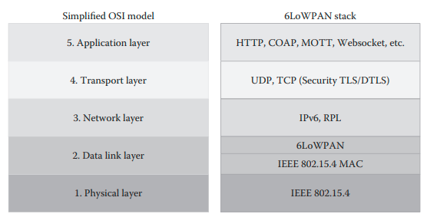
Protocol stack of 6LoWPAN
Many protocols such as ZigBee require complex application layer gateway in order to connect to the Internet.
6LoWPAN solves this issue with the help of an adaptation layer that is present in between the IP stack’s data link and network layer. The adaptation layer allows transmission of IPv6 data grams over IEEE 802.15.4

Slide 22
Protocol stack of 6LoWPAN (Cont..)
The main responsibility of application layer is data formatting.
A popular application layer that is used in the Internet is HTTP that runs over TCP.
HTTP uses XML that in turn is a text-based language with a large overhead. Hence, it is not suitable for 6LoWPAN systems that have low power consumption.
Several other alternatives like COAP and MQTT are used in 6LoWPAN systems.
6LoWPAN is very promising for use in the IoT market because of the following reasons
◾ Support for IP communication
◾ Support for large mesh network topology
◾ Very low power consumption
◾ Robust communication capabilities

Slide 23
Bluetooth Low Energy (BLE)
BLE was started as part of the Bluetooth 4.0 core specification.
BLE uses short-range radio with minimum power and operates for a long time. Its range coverage is about 100 meters, which is roughly about 10 times more than conventional Bluetooth.
Latency of BLE is 15 times lesser than that of conventional Bluetooth.
BLE operates using a power between 0.01 mW and 10 mW.

Slide 24
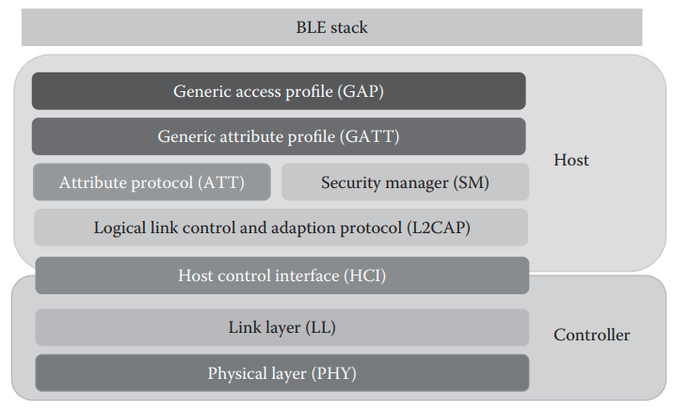
Protocol stack of BLE

Slide 25
Protocol stack of BLE
Physical layer: This layer receives and transmits data bits.
Link layer: functions performed by the link layer: – Media access control – Error control – Connection establishment – Flow control
Host control interface (HCI): Provides a command, event, and data interface that allows link layer to access the data from upper layers such as GAP, L2CAP, and SMP.
Logical link control adaptation protocol (L2CAP): This layer mainly performs multiplexing of data channels. This layer also does fragmentation and reassembly of larger packets.

Slide 26
Protocol stack of BLE - GAP
Generic Access Profile (GAP): Defines processes related to the discovery of Bluetooth devices and also lays down link management aspects while establishing connection between Bluetooth devices.
Different types of roles defined by GAP when operating over low-energy (LE) physical channel:
Broadcaster role: A device that operates in this role can send advertising events. The device that operates in this role is referred to as a broadcaster. The broadcaster has a transmitter and may have a receiver as well.
Observer role: A device that operates in this mode can receive advertising events. The device is referred to as an observer. The observer has a receiver, and it may have a transmitter as well.
Peripheral role: A device that is in the peripheral role accepts the establishment of an LE physical connection. A device that operates in the peripheral role will be in a slave role in the link layer connection state. A device that operates in the peripheral role is called a peripheral device. A peripheral device has both a transmitter and a receiver.
Central role: A device that is in central role initiates establishment of a physical connection. A device that is operating in central role will be in a master role in the link layer connection. A central device has both a transmitter and a receiver.

Slide 27
Protocol stack of BLE- GATT
Generic attribute profile (GATT) specifies a framework using the attribute protocol (ATT) layer.
It mainly defines services and their characteristics. GATT lays down various aspects of service such as service procedures, characteristics, and various aspects that pertain to the broadcast of service characteristics.
The two roles that are specified by GATT profiles.
◾ GATT client: Any device that wants data is called a GATT client. It sends requests and commands to the GATT server. A GATT client can receive responses and other notifications sent by the GATT server.
◾ GATT server: Any device that has the data and can accept incoming requests from the GATT client is called GATT server. A GATT server sends responses to a GATT client.

Slide 28
Protocol stack of BLE- ATT, SMP
The ATT layer defines a client or server architecture above the BLE logical transport channel.
The layer allows a GATT server to communicate with a GATT client by exposing a set of attributes and interfaces.
Security Manager Protocol (SMP) specifies the procedures and behavior to ensure security by managing pairing, authentication, and encryption between the devices.

Slide 29
EPCglobal
Electronic product code (EPC) is a unique identifier stored in an RFID tag that helps to identify and track items in a supply chain management scenario.
EPCglobal also prepares and maintains standards that are related to RFID and EPC
◾ Openness ◾ Scalability ◾ Reliability
◾ Support for object IDs and service discovery
The key components of EPCs are classified into four types:
◾ 96-bit ◾ 64-bit (I) ◾ 64-bit (II) ◾ 64-bit (III)
All types of 64-bit EPCs provide support for about 16,000 companies with unique identities and cover 1–9 million types of products and 33 million serial numbers for each type.
The 96-bit type provides support for about 268 million companies with unique identities, 16 million classes of products, and 68 billion serial numbers for each class.

Slide 30
EPCglobal – Cont..
An RFID tag has two main components:
- electronic chip to store the identity of the object
- antenna that allows the chip to communicate with the tag-reader system.
The communication between the tag and tag reader happens with the help of radio waves.
The two main components of an RFID system are:
◾ Radio signal transponder ◾ Tag reader
i) The tag reader generates a radio field that can identify objects using reflected radio waves of the RFID tag.
ii) RFID system works by sending the tag number to the tag reader with the help of radio waves.
iii) After that, the RFID tag reader passes on the tag number to a specific application which is called object-naming services (ONS).
iv) The ONS can perform a look-up operation to get further details of the tag such as the place of manufacture and the year of manufacture.17

Slide 31
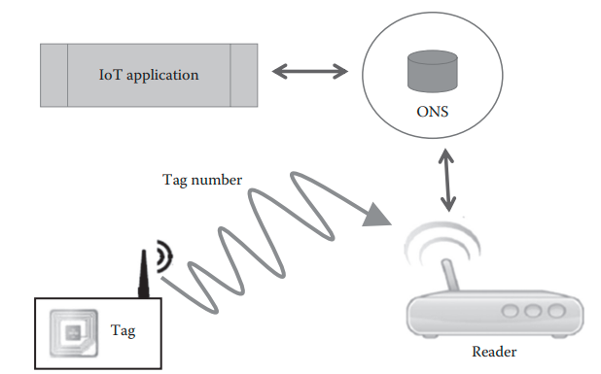
Components of RFID

Slide 32
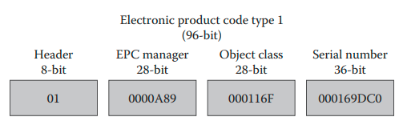
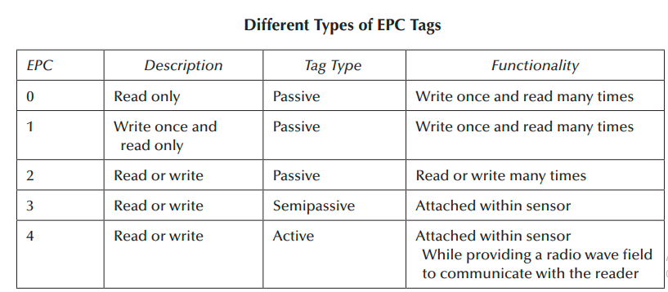
EPC code

Slide 33
Long Term Evolution-advanced (LTE)
Long term evolution-advanced (LTE) also referred to as 4G LTE is a standard for wireless mobile network, and it provides high speed data transfer rates for wireless networks.
50 times performance improvement for existing wireless networks.
LTE broadcast is a single frequency network (SFN) that operates in a broadcast mode. It is a part of the series of standards known as evolved multimedia broadcast multicast service (eMBMS).

Slide 34
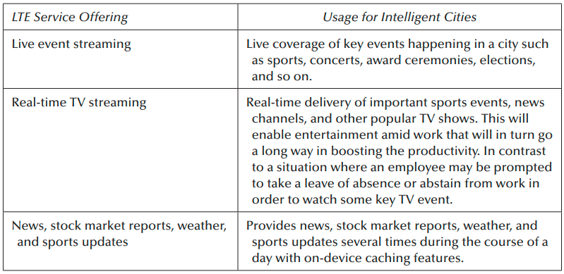
Key Use Cases of LTE

Slide 35
Z-Wave
Z-Wave is a low-power wireless communication protocol that is mainly used for home area networks (HAN).
Remote control applications for smart homes as well as other small-sized commercial domains.
Z-Wave was developed by ZenSys and later on improved by Z-Wave alliance.
Z-Wave operates mainly in the sub-GHz frequency range that is typically around 900 MHz.
Uses low-powered mesh networking topology.

